Slide 1
“Why Can’t I Learn Programming?”
The Learning and Teaching Environment of Programming
Zsuzsanna Szalayné Tahy
ELTE IK
sztzs@caesar.elte.hu
Zoltán Czirkos
BME VIK
czirkos@eet.bme.hu

Slide 2
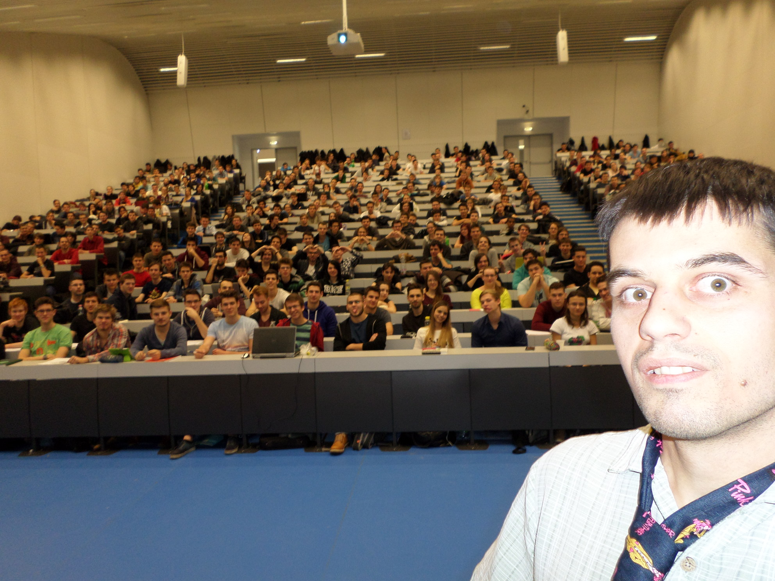

Slide 3
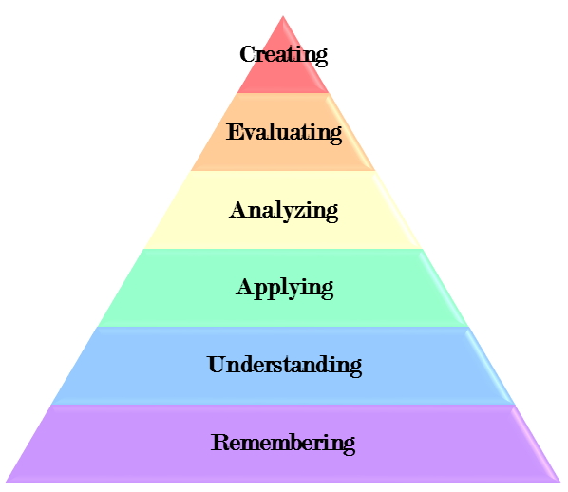
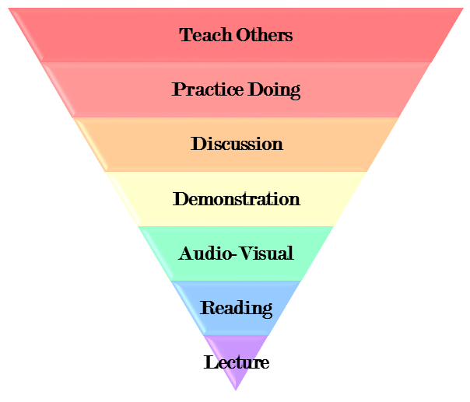
Pedagogical Background
Bloom’s taxonomy
Learning Pyramid
Curriculum designs
Teaching methods
Classroom practice

Slide 4









Learning Activity Unit a Quick Analysis Tool
Initial learning
Active
Moderated
Passive

Slide 5
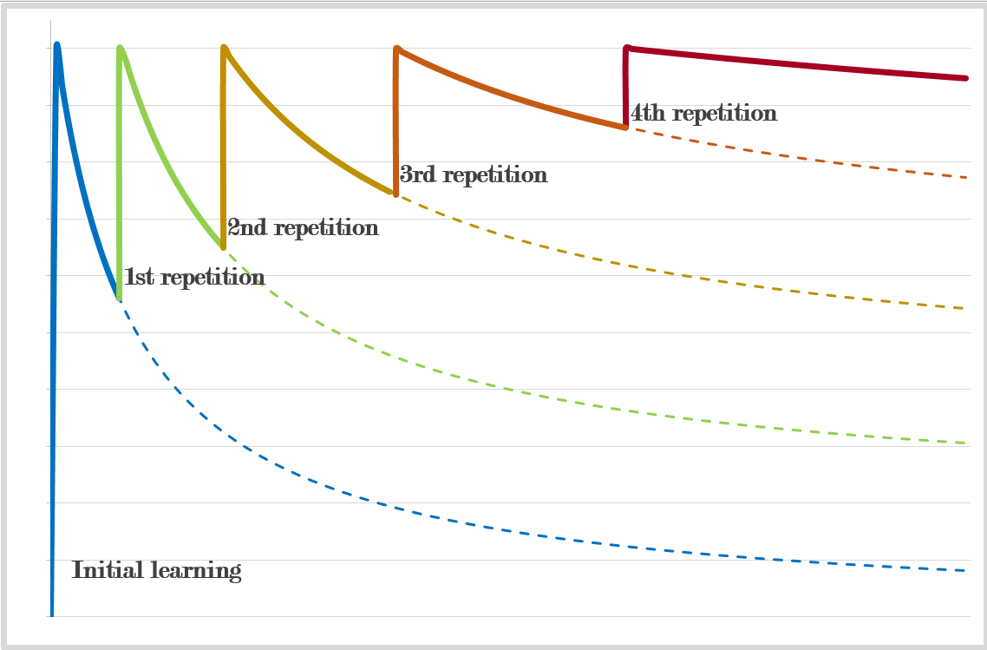
Learning Activity Unit a Quick Analysis Tool
Active Moderated Passive
1. Initial learning
2. Trying
3. Experimenting
4. Pause
Repeating
5. Using
Modifying
Creating

Slide 6
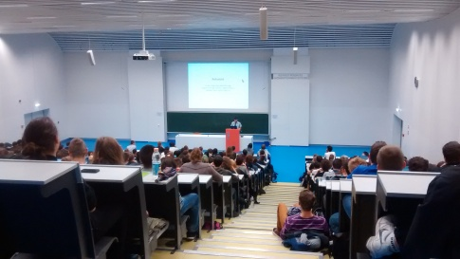
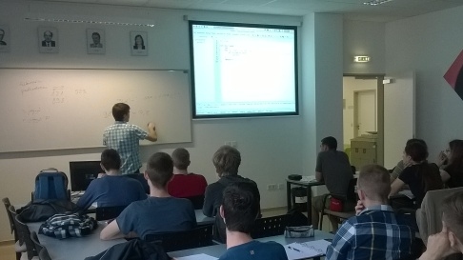
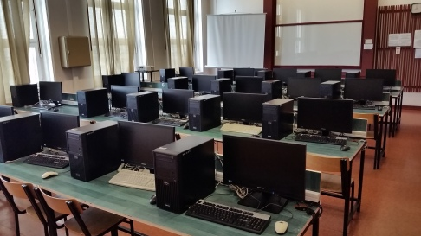
Learning Activity Unit a Quick Analysis Tool
AMP
1. Init
2. Try
3. Exp
4. Pause
5. Use
R
M
C

Slide 7
Learning Activity Unit a Quick Analysis Tool
AMP
1. Init
2. Try
3. Exp
4. Pause
5. Use
R
M
C
Home Work

Slide 8
Portion of Informatics in the Curriculum

Slide 9

Learning in School
National Curriculum
Frame Syllabus
AMP
AMP
1. Init
1. Init
2. Try
2. Try
3. Exp
3. Exp
4. Pause
4. Pause
5. Use
5. Use
R
R
M
M
C
C

Slide 10
Code Week…
(15.10-23.10)
Scratch activity (example)
  2014
  2015
  2016
Efficiency
  Very interesting
  Interesting
  Boring
AMP
1. Init
AMP
1. Init
2. Try
AMP
2. Try
3. Exp
1. Init
3. Exp
2. Try
4. Pause
3. Exp
4. Pause
4. Pause
Company’s teaching action
Hour of Code
Coding Girls

Slide 11
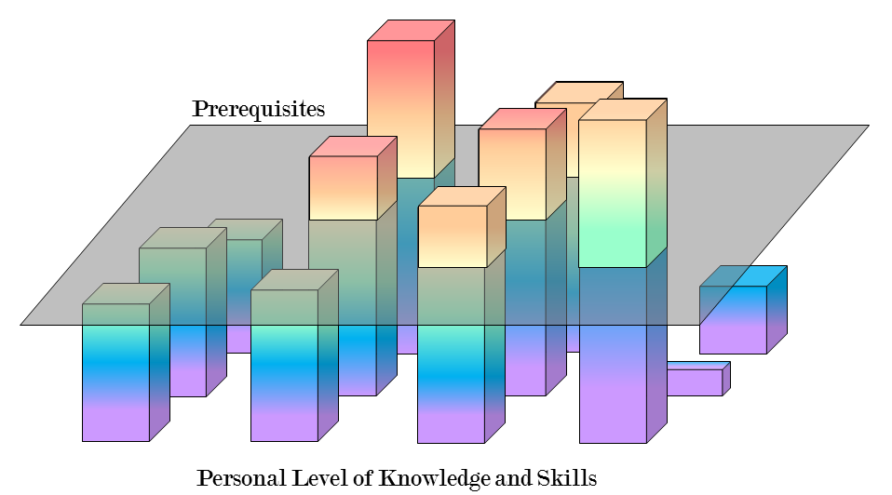
The Base of Programming
Abstraction
English
Algorithmic thinking
Typing
Logic decision

Slide 12
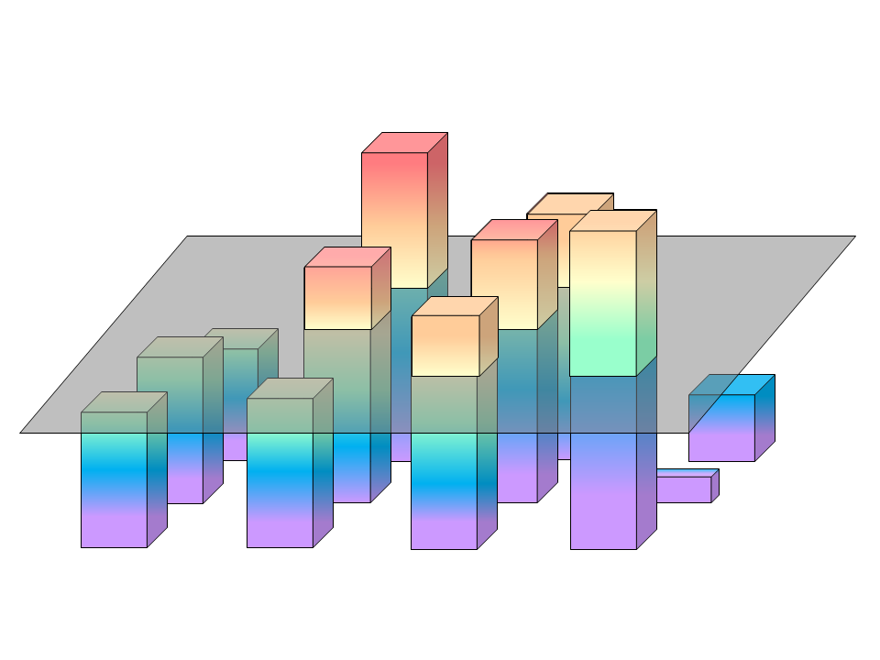
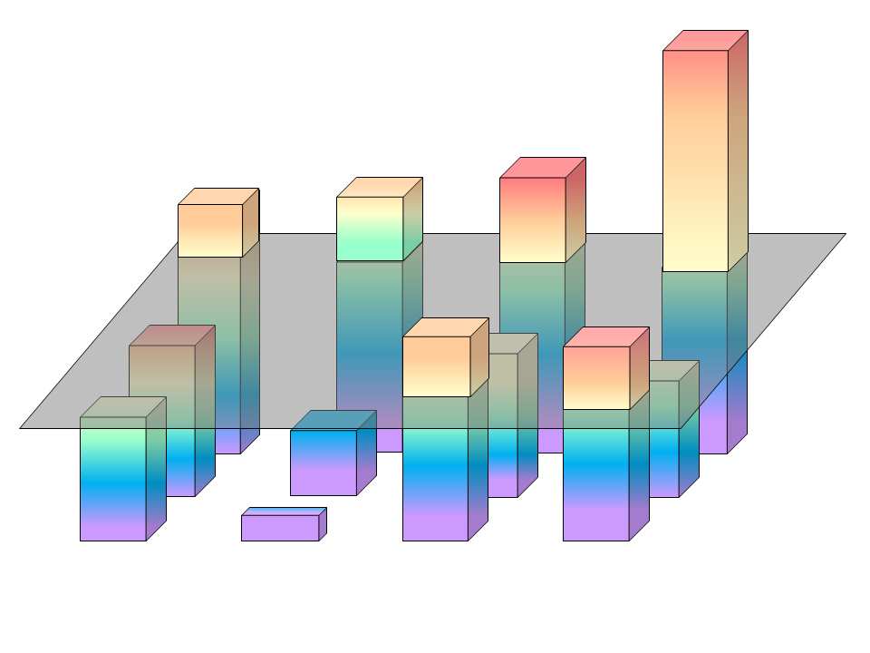
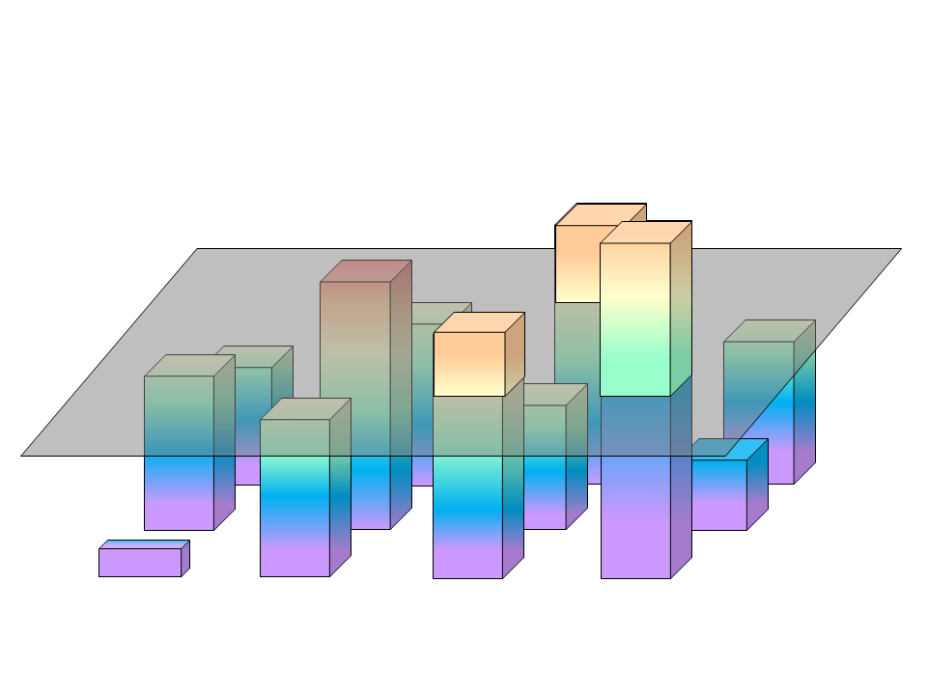
Teaching programming
Long term
Customization
  Custom methods
  Custom learning paths
Improve thinking process, creativity

