Slide 1

Teaching Programming Indirectly with Paint
Zsuzsanna Szalayné Tahy
Eötvös Loránd University, Faculty of Informatics
sztzs@caesar.elte.hu
ISSEP 2015 Ljubljana

Slide 2
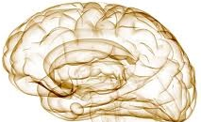
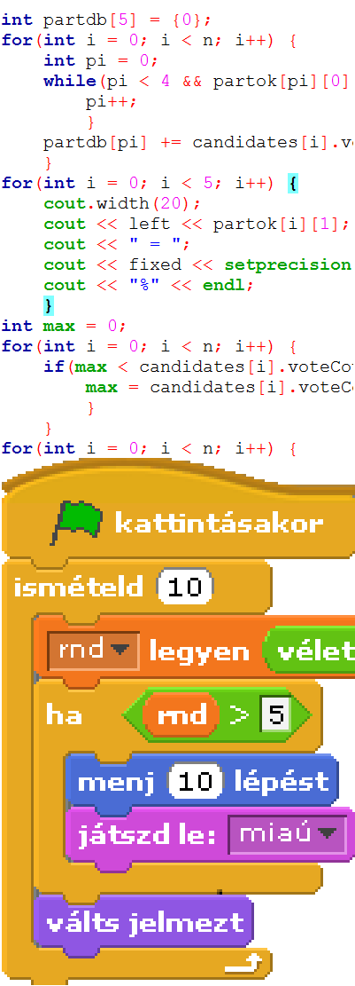

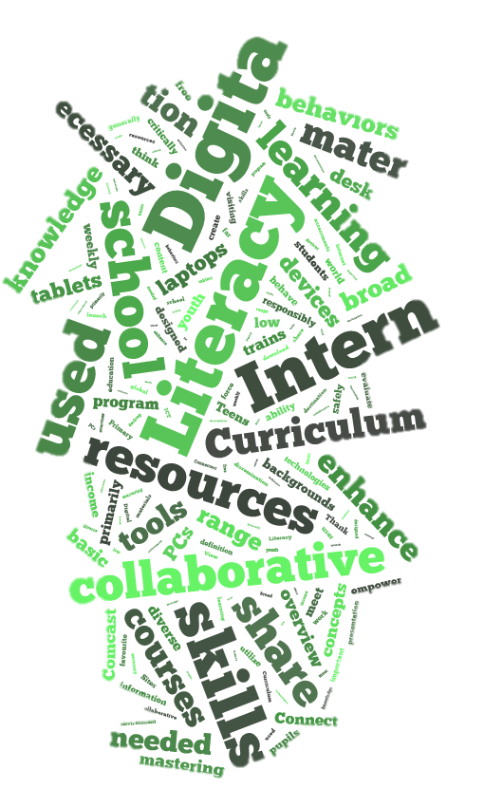
Everybody Have to Learn Programming
Computational Thinking
Programming
knowledge
Digital Literacy
ISSEP 2015 Ljubljana

Slide 3

Everybody Learn Programming, But…
Computational Thinking
Programming
knowledge
Digital Literacy
ISSEP 2015 Ljubljana

Slide 4
Indirect Programming
Computational Thinking
Digital Literacy
&
Programming
ISSEP 2015 Ljubljana

Slide 5
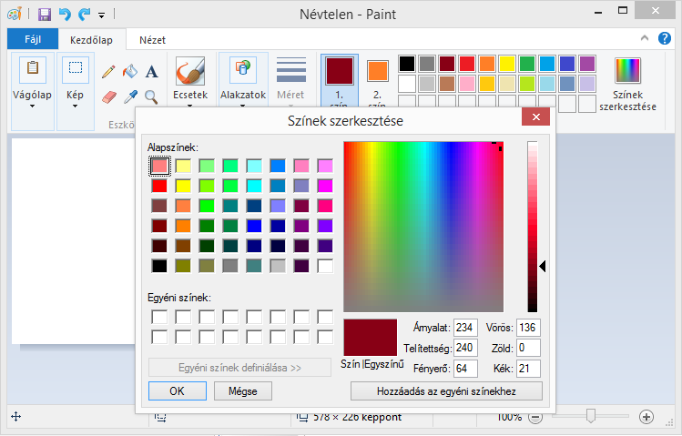
Example 1 - Color
What does Paint do?
Look inside!
Brush
Color
RGB
Data
How does it work?
Pixel
What does it mean?
Object
Byte
ISSEP 2015 Ljubljana

Slide 6
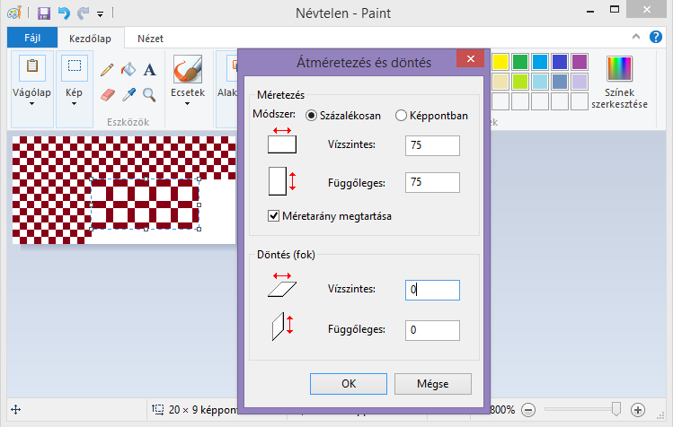
Example 2 - Resize
What does Paint do?
Byte
Look inside!
Data
RGB
Array
How does it work?
Pixel
What does it mean?
Object
Algorithm
Resize
ISSEP 2015 Ljubljana

Slide 7
Improve Digital Literacy
Spreadsheets
Programming
Texteditor
Algorithm
RGB
Array
Data
Resize
Byte
Object
Copy
Pixel
Shape
Color
Brush
Explore
Program
Save
×
Use
Application
Click
Software
ISSEP 2015 Ljubljana

Slide 8
Summary
Graphical software, Paint…
  Software
  Application
  Program
Teach the…
  Use of application &
  Bases of programming
Earlier than formal coding
ISSEP 2015 Ljubljana

