Slide 1

How to Teach Programming Indirectly
– Using Spreadsheet Application
Zsuzsanna Szalayné Tahy
Eötvös Loránd University, Faculty of Informatics
sztzs@caesar.elte.hu
5th MathInfo Conference - 2015

Slide 2


Everybody Have to Learn Programming
Computational Thinking
Programming
knowledge
Digital Literacy
5th MathInfo Conference - 2015

Slide 3

Everybody Learn Programming, But…
Computational Thinking
Programming
knowledge
Digital Literacy
5th MathInfo Conference - 2015

Slide 4
Indirect Programming
Computational Thinking
Digital Literacy
&
Programming
5th MathInfo Conference - 2015

Slide 5
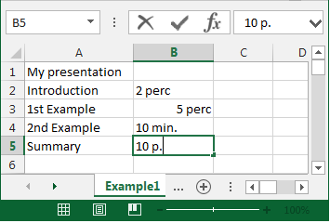
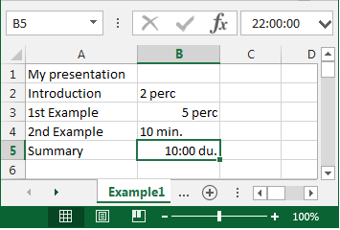
Example 1 - Data Types
How to write data?
  click, cell width,
How to solve problem?
  Format|Cells| Number
What does
Excel do?
  parses
  converts
  data types
5th MathInfo Conference - 2015

Slide 6
Example 1 - Data Types
String
Number
  Fraction
  Scientific
  Currency
  Percent
  …
Date
  String
  Number
    Date
    Time
Boolean
5th MathInfo Conference - 2015

Slide 7
Example 2
Limits of Spreadsheets
How can I get the last row/column?
How many cells are on the sheet?
  …and if I insert more rows, columns
Special numbers: 2²⁰ and 2¹⁴
  Max size of spreadsheets:
  2²⁰ × 2¹⁴ × 2⁸ × 2¹⁵ → 2⁵⁷ Byte = 128 pebi B
RAM? Hard disk? Cloud?
Phone book? (database, text editor)
5th MathInfo Conference - 2015

Slide 8
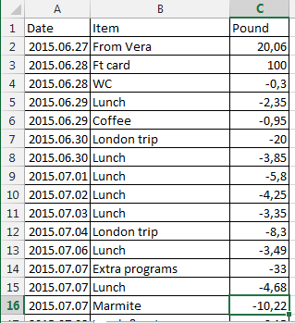
Example 3
Cost Accounting
How can I write formula or function?
Formula or function?
  Formula: +, -, *, /, ^
  Function: SUM()
    …and more 150 types
5th MathInfo Conference - 2015

Slide 9
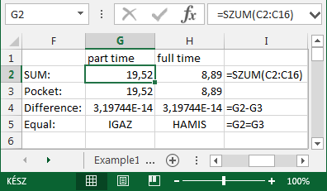
Example 3
Cost Accounting or an Equality Problem
The difference is not 0
  though they seem to be equal… or not.
5th MathInfo Conference - 2015

Slide 10
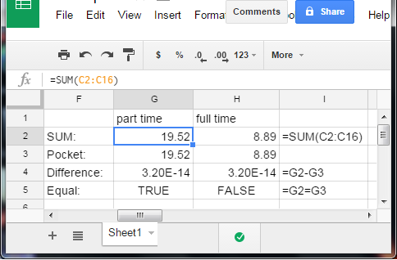
Example 3 an Equality Problem
The difference is not 0
  though they seem to be equal… or not.
5th MathInfo Conference - 2015

Slide 11
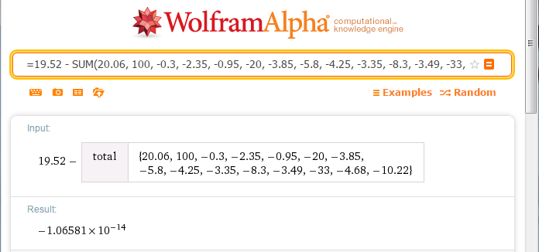
Example 3 an Equality Problem
The difference is not 0
5th MathInfo Conference - 2015

Slide 12
Example 3 an Equality Problem
The difference is not 0
→ stupid software?
  Binary implementation
  Integer, float
  Precision
Everywhere!
5th MathInfo Conference - 2015

Slide 13
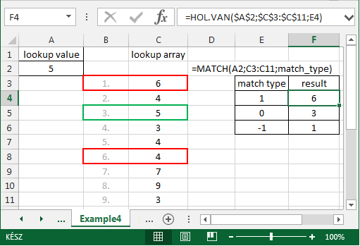
Example 4
MATCH(), VLOOKUP(), HLOOKUP()
How to write arguments?
How to use?
5th MathInfo Conference - 2015

Slide 14
Example 4
MATCH(), VLOOKUP(), HLOOKUP()
What does functions do?
  Searching
  Linear search - exact
  Binary search - interval
  Precondition
  (order before search?)
  Efficiency
5th MathInfo Conference - 2015

Slide 15
Summary
Spreadsheet, Excel is a(n)…
  Software
  Application
  Program
Teach the…
  Use of application &
  Bases of programming
Much earlier than formal coding
5th MathInfo Conference - 2015

Slide 16
How to Teach Programming Indirectly
– Using Spreadsheet Application
Thank You…
Zsuzsanna Szalayné Tahy
Eötvös Loránd University, Faculty of Informatics
sztzs@caesar.elte.hu
5th MathInfo Conference - 2015

